Slide 1

Oxford Road Datalake

Slide 2
About Oxford Road
Founded - 2013
Industry – Advertising and Marketing
CEO - Dan Granger
Revenue ~ $8 Mn
3-Year Growth – 1,098 %
Location – Los Angeles
Employees Count – 40
Oxford Road was ranked #398 on the 2017 Inc 500 list of fastest growing companies in Inc Magazine.
Oxford Road producing and placing ads on traditional media channels like television, terrestrial and satellite radio, new media channels such as streaming audio and video, and on-demand content like Podcast and Video On Demand(VOD).

Slide 3
Business Need and Challenge
Requirements
Centralizing media data from Media Buying Platforms (Postlog, Strata)
Appending performance data from Google Analytics, client e-mails
Enriching data from third party data sources
Automation of Data Loading and Report publishing
Challenge
Company wide data silos
Lack of data quality
Lack of data management and governance
Heavy dependence on analysts’ manual efforts for weekly reporting

Slide 4
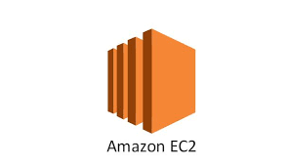

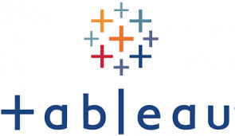



Existing Architecture
Data Sources
1. Strata
2. Magellan
3. Networks
4. Clients
Data Types
1. Media
2. Performance
3. Attribution
Data Tables
1. Strata Digital
2. Strata Spot
3. Magellan
4. Streaming
Etc.
Transform with Python Modules
Custom SQL
Data Formats

Slide 5
Issues with the Current System
Timeliness – More time on client on boarding and reports publishing `~ 24 Hours – Manual Process
Flexibility – Not supporting ad-hoc analysis
Quality – No Data Model and Lineage
Findability – Hard for Non-IT people/ Business Analyst
Scalability – Unable to process the large volume of data

Slide 6
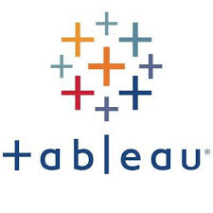




Proposed High Level Solution
Source Systems
Storage
Compute
Compute
Database
Visualization
Post Log
(PDF, Excel,
E-Mail)
Tableau
Strata
(API)
AWS S3
Lambda
ETL Glue
Red Shift
Google Analytics
/Periscope
Machine
Learning
Other Sources (Heroku)
Monitor/Security
Cloud Watch
IAM Security
Athena
Notes:
Attribution Model, Forecasting and Prediction

Slide 7



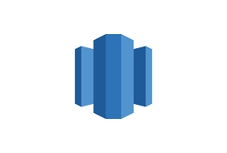



Solution Flow
Data Sources
1. Strata
2. Magellan
3. Networks
4. Clients
CloudWatch
Data Types
1. Media
2. Performance
3. Attribution
Data Definition Queries
Parse/Transform with Python Modules to feed to S3
Lambda
Custom SQL
(Not Scalable)
Glue
Or
EMR
Redshift
Or
Athena
Partitioned/ Normalized
Tables
Data Formats
(Scalable)

Slide 8


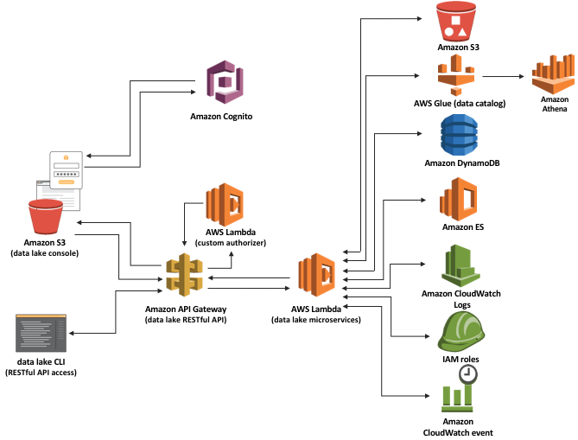
Foundation based on AWS Recommended Data Lake Solution
-- Included in proposed architecture

Slide 9
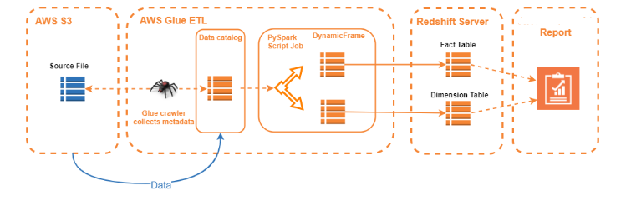
Glue ETL Flow Diagram

Slide 10
Our Solution
Advantages
Centralized, Cloud based, Scalable approach
Normalized Database design – Dimension Data Model
Modular Codes
Configurable externally

Slide 11

New Architecture – Description of Components
AWS S3
Distributed data storage as a service.
AWS Lambda
Event driven scalable functions.
AWS Glue
ETL Service to discover data in AWS and catalog them, create and customize ETL jobs on cataloged data, run generated ETL jobs at scale.
AWS EMR
Clusters serviced with distributed frameworks of choice. Can be used to run any kind of distributed jobs on any combination of distributed frameworks like Hadoop, Spark(has MLLib), Hive etc.
AWS RedShift
Enterprise-class scalable relational data warehouse.
AWS Athena
An interactive query service that makes it easy to analyze data in Amazon S3. Priced by amount of data scanned.
AWS CloudWatch
Cloud monitoring service.

Slide 12


Business-led solutioning saves significant Amount of Time as compared to a Typical IT Solution
Comparison for a Data Lake PoC - 3 Member Team
S.No. | Tasks | IT Company Estimation
1 | Data Lake Application and Storyboarding | 3 weeks
2 | Data Lake Environment Setup | 2 weeks
3 | Data Modelling and Data Pipeline - Data Lake Development | 9 weeks
4 | Data Lake Dashboards | 2 weeks
Total |  | 16 Weeks
S.No. | Tasks | Business-led Solutioning
1 | Requirement Gathering and Data Lake Setup | 1 week
2 | Data Pipeline and Data Model Review | 1 week
3 | Error Handling, Testing, Data Load on to Data Lake | 3 weeks
4 | Data Visualization and Documentation | 1 week
Total |  | 6 Weeks
60% Reduction in Time Consumed and Cost

Slide 13
Business Impact
Other Key Benefits:
Dashboard timeliness reduced from 24 hours to less than 30 minutes.
Reduced 50% cost of development and testing using local development environment
Reduced 80% of manual work and dependence of analysts
Collect and store any type of data, at any scale, and at low cost.
Secure the data and prevent unauthorized access
Catalog, search, and find the relevant data in the central repository
Quickly and easily perform new types of data analysis, predictive analytics, artificial intelligence (AI), and machine learning.

Slide 14
LatentView’s Benefits
Our Benefits:
$60,000 revenue realisation till date.
$100,000 in pipeline for, ML (Causal Impact, Flighting, Recommendation System) and Data Governance implementation (Web app)
Gained significant domain knowledge on end-to-end media selling and analysis. This can potentially be converted into a readily delivered analytic solution.

Slide 15
Customer Feedback
“ I am happy with the progress made so far and helping me achieve the vision of centralizing the data and automating the reporting. I am thoroughly impressed with every interaction we had and the work product you shared.
The real value for our agency lies in the time to insight and time to business value. By automating the reporting, we can focus more on mining insights through Analytics (and Machine Learning). I feel we are getting a lot closer to making this dream a reality.
Thank you for all of your efforts, specifically navigating through our custom processes and the minimal documentation. It is very much appreciated.
Look forward to making this project successful “
Goutham Budati Director of Analytics
OXFORd.

Slide 16
Thank you

